Slide 1
A RAG-Powered Chatbot for CyberArk API Documentation
By Saya, Venkata Thrivedi – 2023AA05203

Slide 2
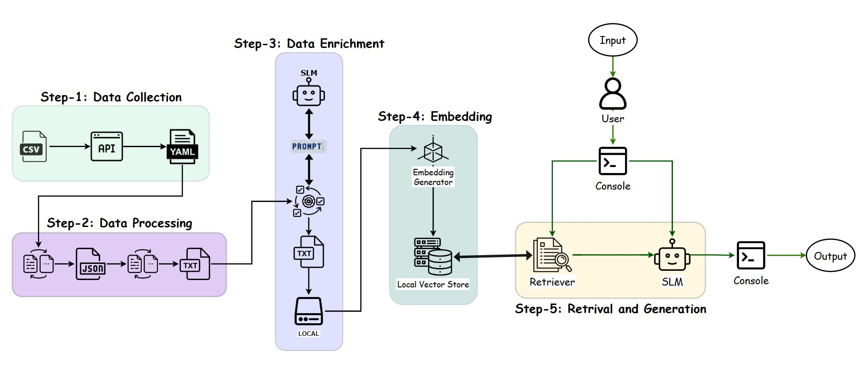
Architecture Diagram

Slide 3
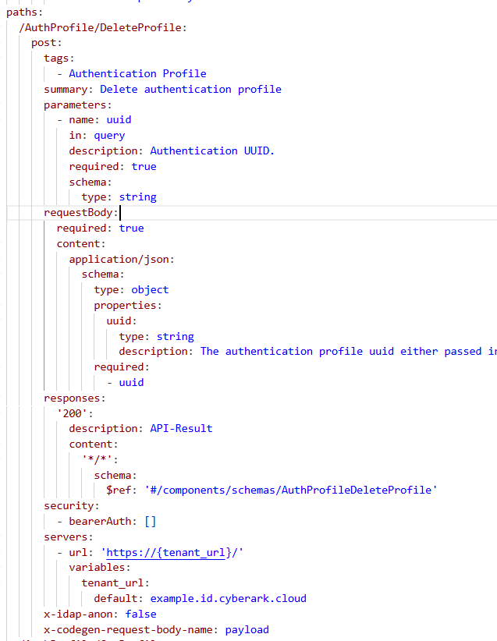
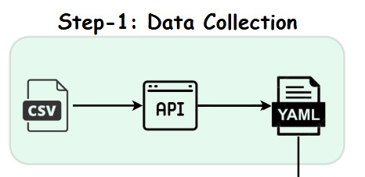
Step-1 : Data Collection
OpenAPI Spec File
Sample YAML file for an Endpoint =>

Slide 4
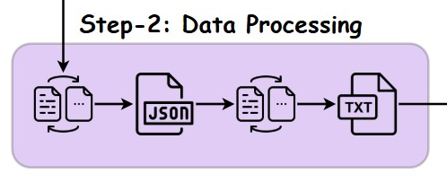
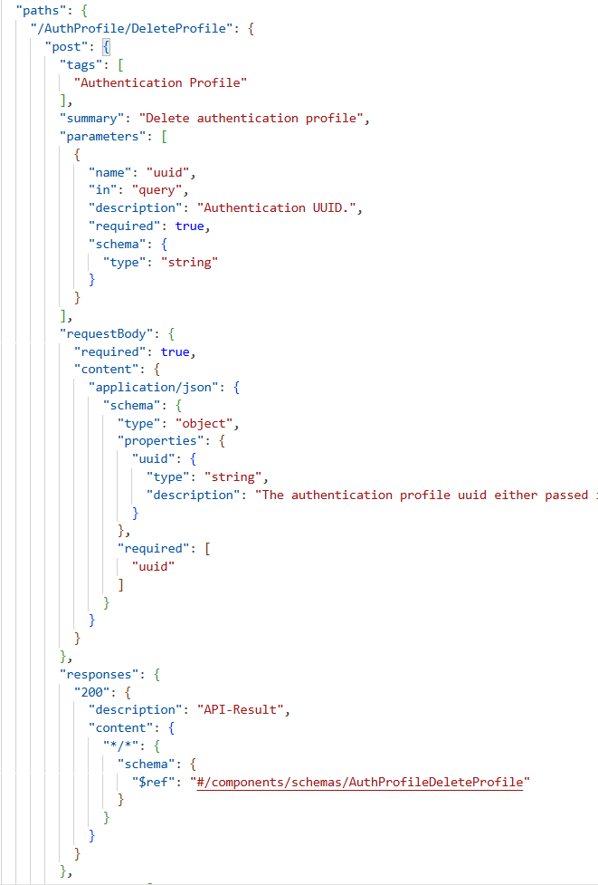
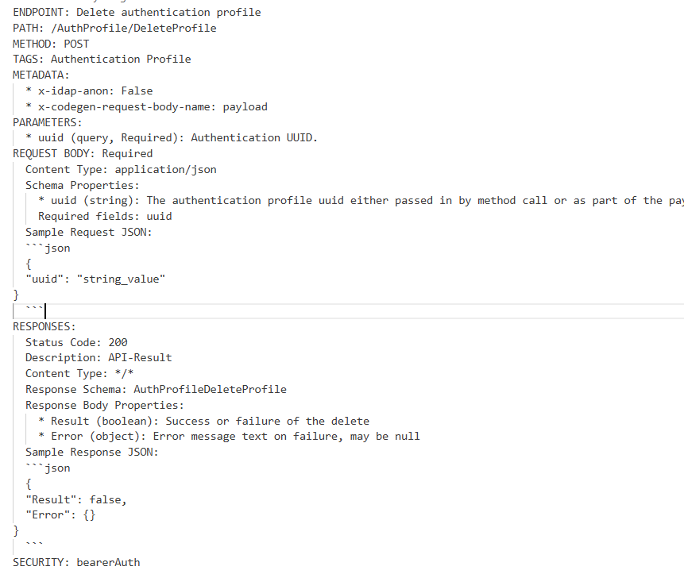
Step-2 Data Processing
=> => => => =>

Slide 5
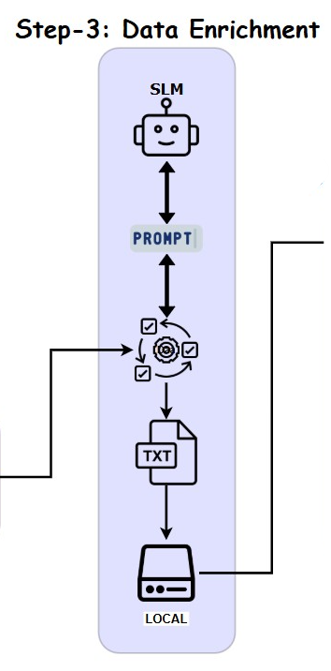
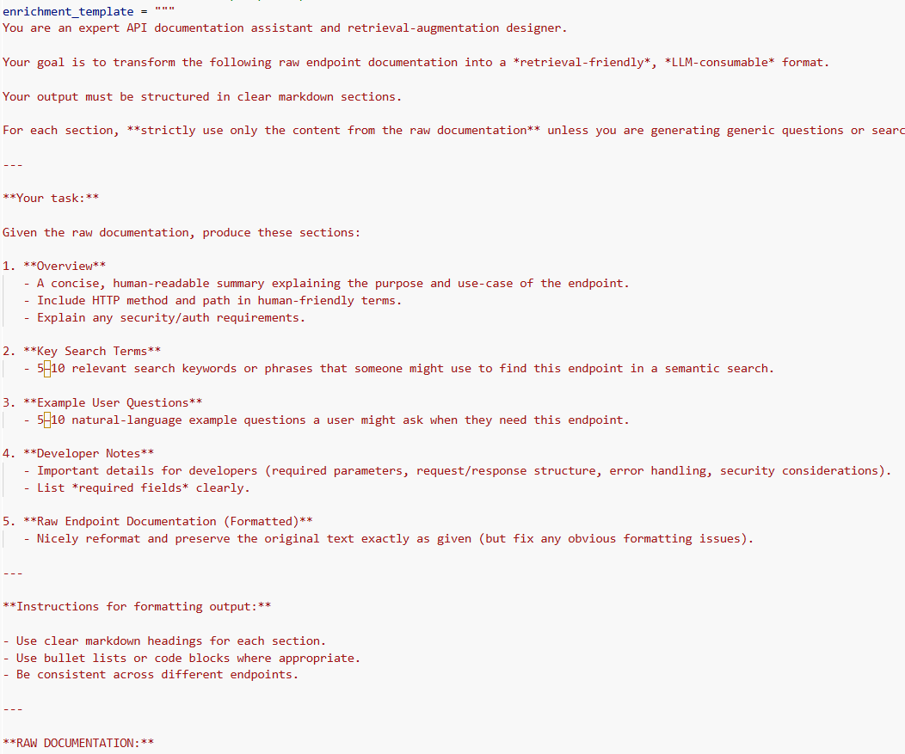
Step-3 Data Enrichment
SLM used is Ollama3.2:latest

Slide 6
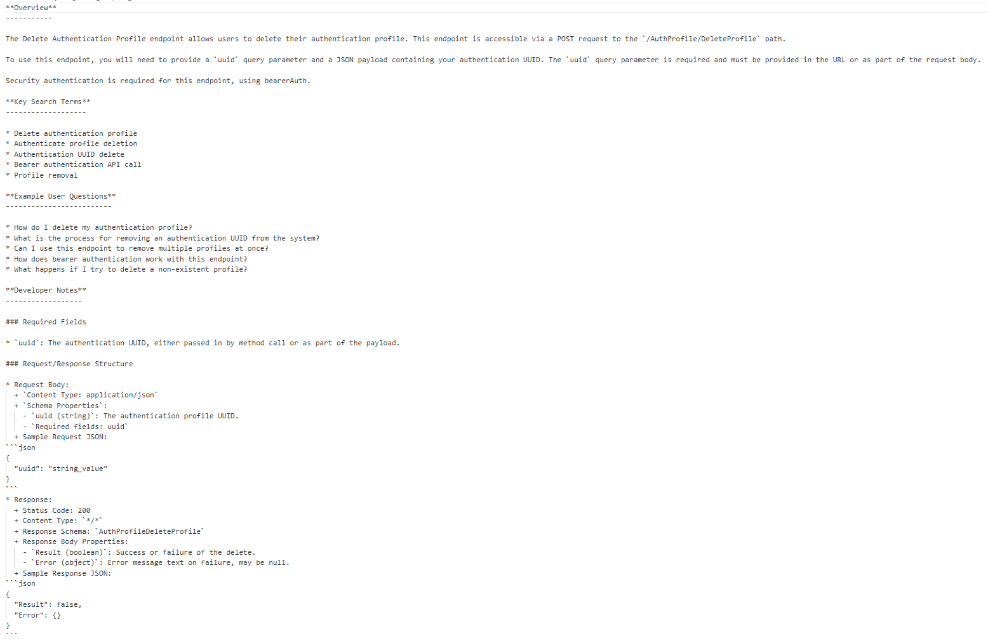
Enriched Text File

Slide 7
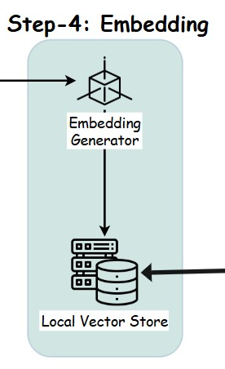
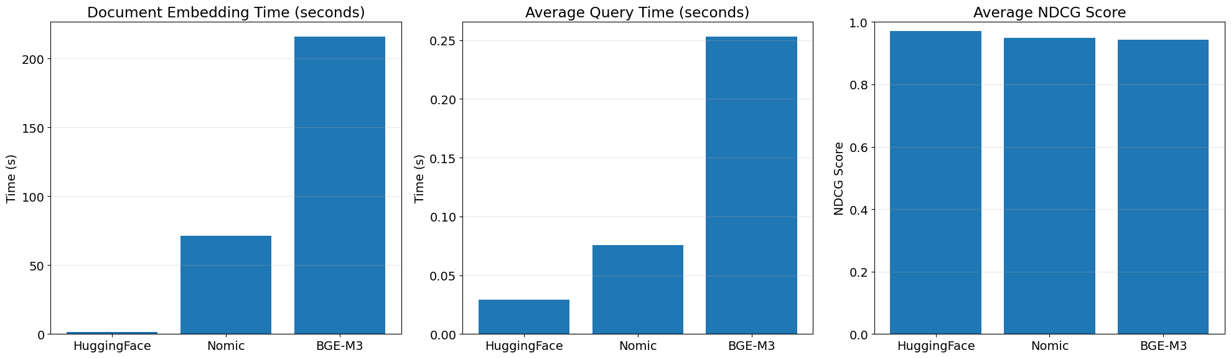
Step-4 Embedding
Studied 3 different type of embedding models
Ollama => nomic-embed-text:latest
- 768 dimensions
Ollama => bge-m3:567m
- 1024 dimensions
HuggingFace => all-MiniLM-L6-v2
- 384 dimensions
Observation: even though `all-MiniLM-L6-V2` has less dimensions, it is able to capture the best balance between retrieval quality and performance for API documentation use case.

Slide 8
Step-4 Embedding
Embedding used : HuggingFaceEmbedding - all-MiniLM-L6-v2 – 384 dimensional
Vector Store used : FAISS (Facebook AI Similarity Search)
--------------------------------------------------------------------------------------------------------------------------------------
Use the Enriched Data as document
Used text splitter to split the document ( ChunkSize : 1000 (balanced granularity) ; Overlap : 100 )
As documents are individual for each endpoint, it is made sure that there is no overlap between the documents and overlap is within the documents.
Once Embedding are generated, they are stored in local to save compute and reuse quickly.
FAISS is used as a vector store, which is an open-source library designed for efficient similarity search and clustering of dense vectors

Slide 9
Step-5 Retrieval and generation - Study
Types of Retrieval and Generation approaches used for study
Simple Ensemble Retrieval Search
Neighbourhood Expansion with Context Aggregation
Multi-Query Generation with BERT-Based Reranking
Recursive Retrieval-Generation with Self-Correction
Dynamic Prompt Engineering with Query-Adaptive Optimization

Slide 10
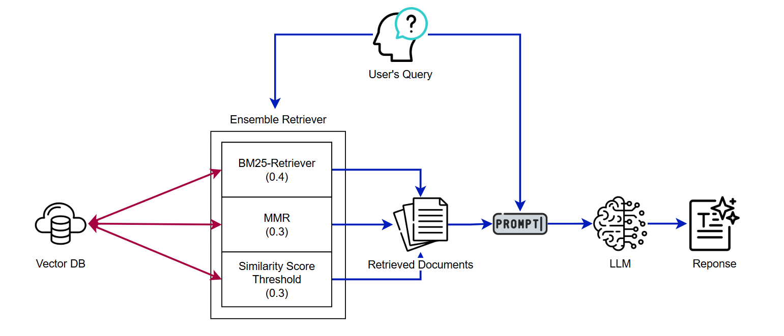
Simple Ensemble Retrieval Search
Notes:
Strengths:
- Fastest and most efficient approach
- Consistent baseline performance
- Easy to implement and maintain
- Good for high-volume, simple queries
Weaknesses:
- Lowest scores across most metrics
- Limited contextual understanding
- May miss nuanced relationships
- Less effective for complex queries

Slide 11
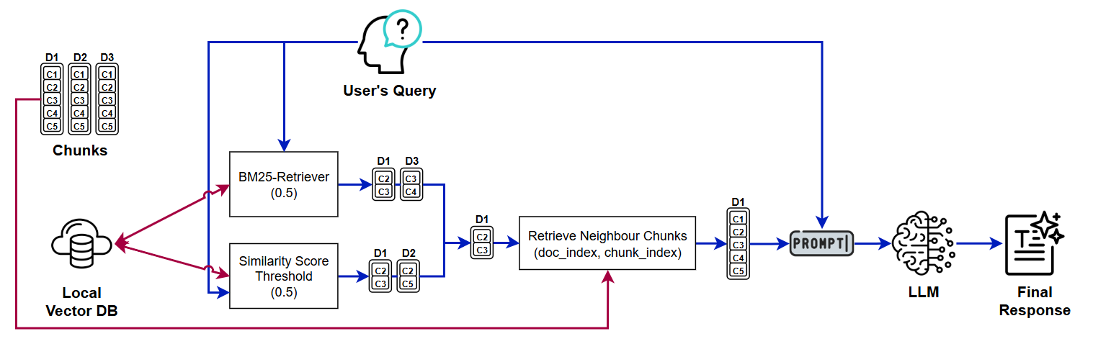
Neighbourhood Expansion with Context Aggregation
Notes:
Strengths:
- Strong contextual understanding through adjacent chunks
- Excellent for questions requiring detailed explanations
- Good balance of performance and cost
Weaknesses:
- May include irrelevant context from adjacent chunks
- Dependent on document structure and chunking strategy
- Less effective for queries spanning multiple documents

Slide 12
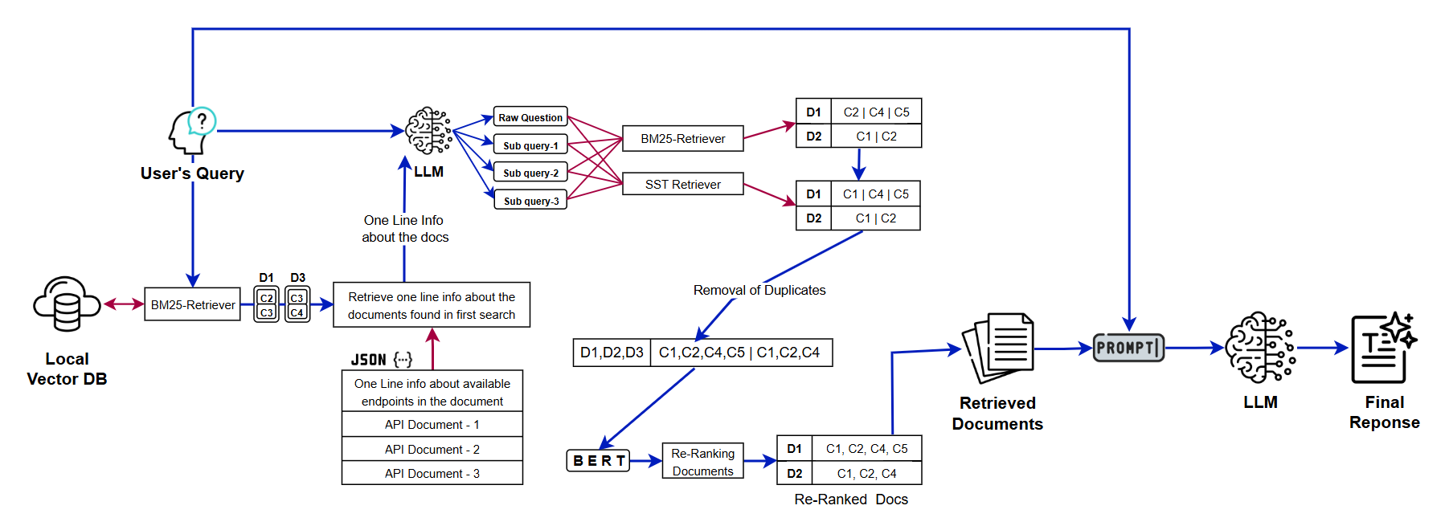
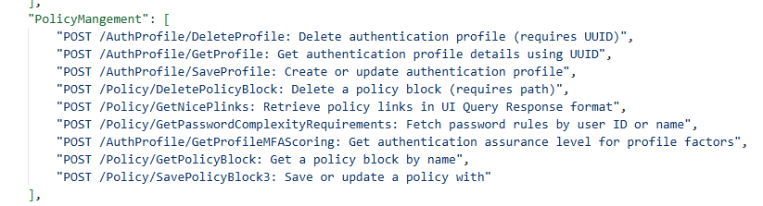
Multi-Query Generation with BERT-Based Reranking
Notes:
Strengths:
- Strong semantic matching capabilities
- Good balance across all metrics
- Effective filtering with similarity thresholds
- Reliable for precise information retrieval
BERT adds semantic intelligence to keyword-based retrieval
BERT understand semantic equivalence “remove” = “delete”
Maps different vocabularies to same semantic space Ex: All authentication-related terms cluster together in embedding space
- Semantic similarity captures paraphrases "bulk" ≈ "batch“ ; "import" ≈ "creation“ ; "spreadsheet" ≈ "CSV"
Weaknesses:
- Additional embedding computation overhead
- May miss relevant docs below similarity threshold if it is high
- Limited context expansion capabilities

Slide 13
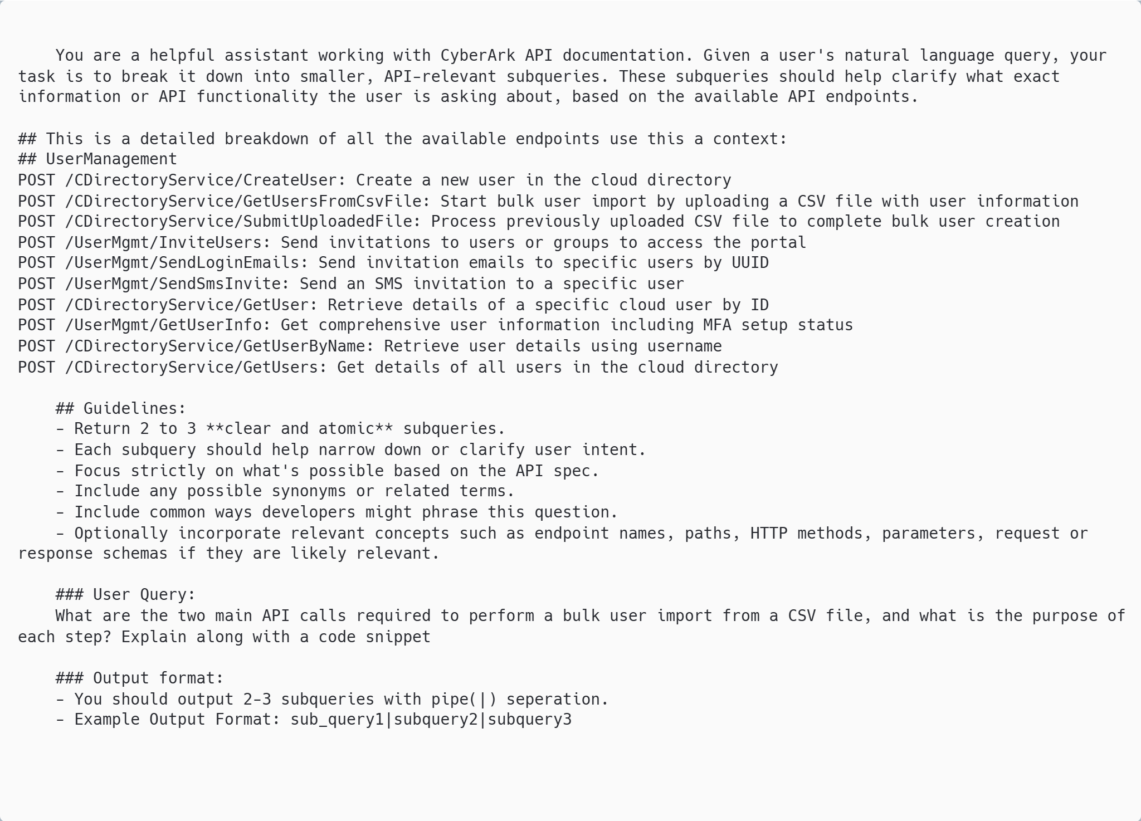
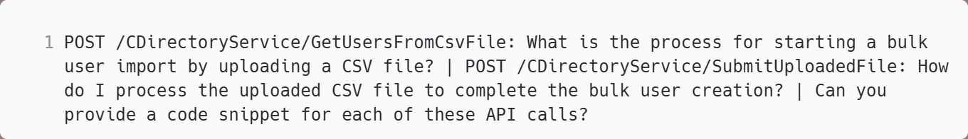
Multi-Query Generation Prompt
Response

Slide 14
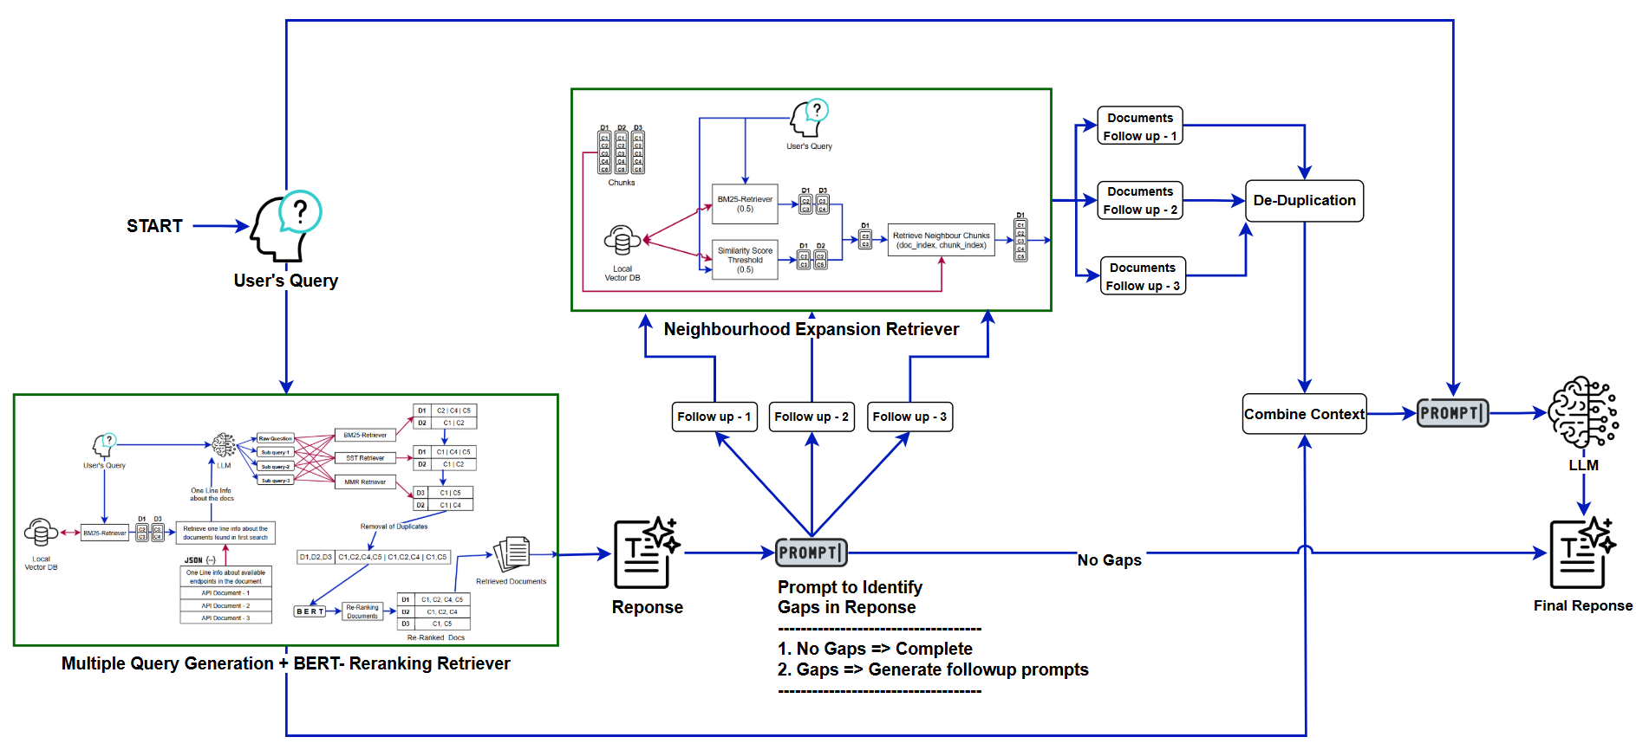
Recursive Retrieval-Generation with Self-Correction
Notes:
Strengths:
- Highest accuracy and completeness
- Self-correcting mechanism identifies and fills knowledge gaps
- Good for complex, multi-faceted questions
- Comprehensive responses with enhanced context
Weaknesses:
- Highest computational cost (multiple LLM calls)
- Longer response times
- May be over-engineered for simple queries
- Complexity can introduce inconsistency

Slide 15
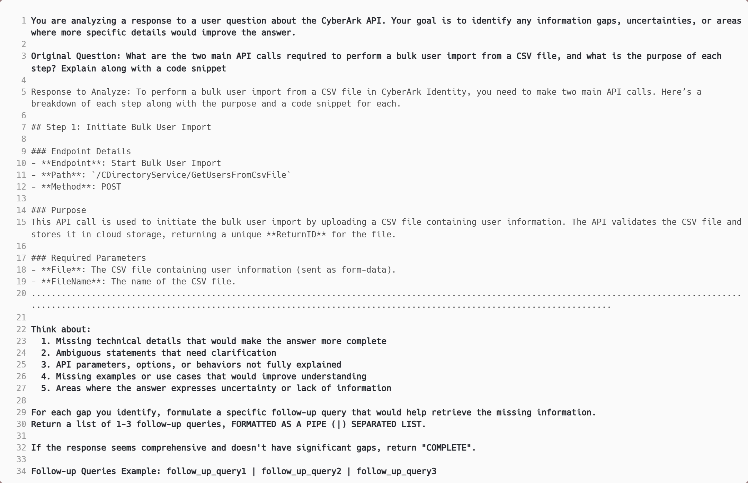
Gap Identification Query
Response

Slide 16
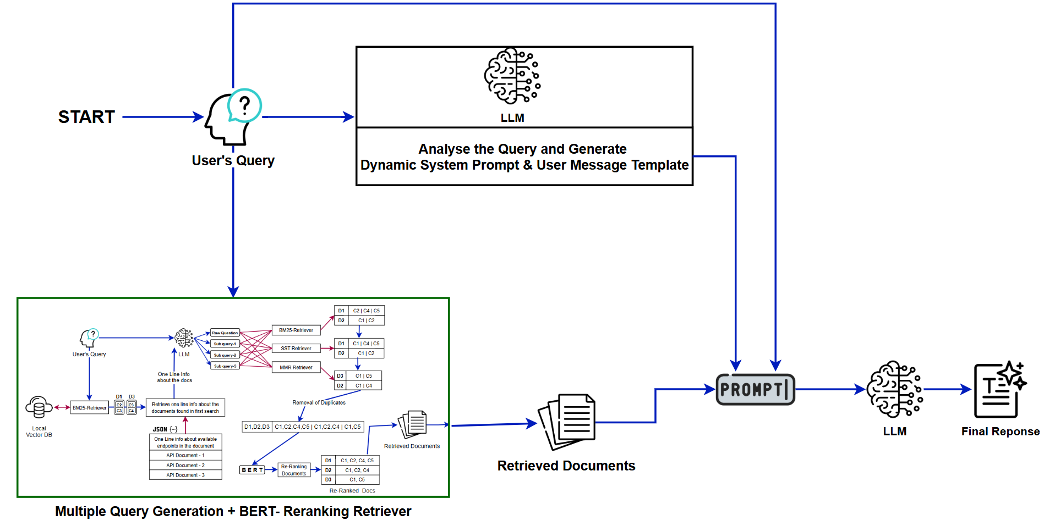
Dynamic Prompt Engineering with Query-Adaptive Optimization
Notes:
Strengths:
- Adaptive to different query types
- High clarity scores
- Customized responses based on query analysis
- Good for diverse question categories
Weaknesses:
- Additional LLM call for prompt generation increases cost
- Performance depends on quality of query analysis
- May over-complicate simple queries

Slide 17
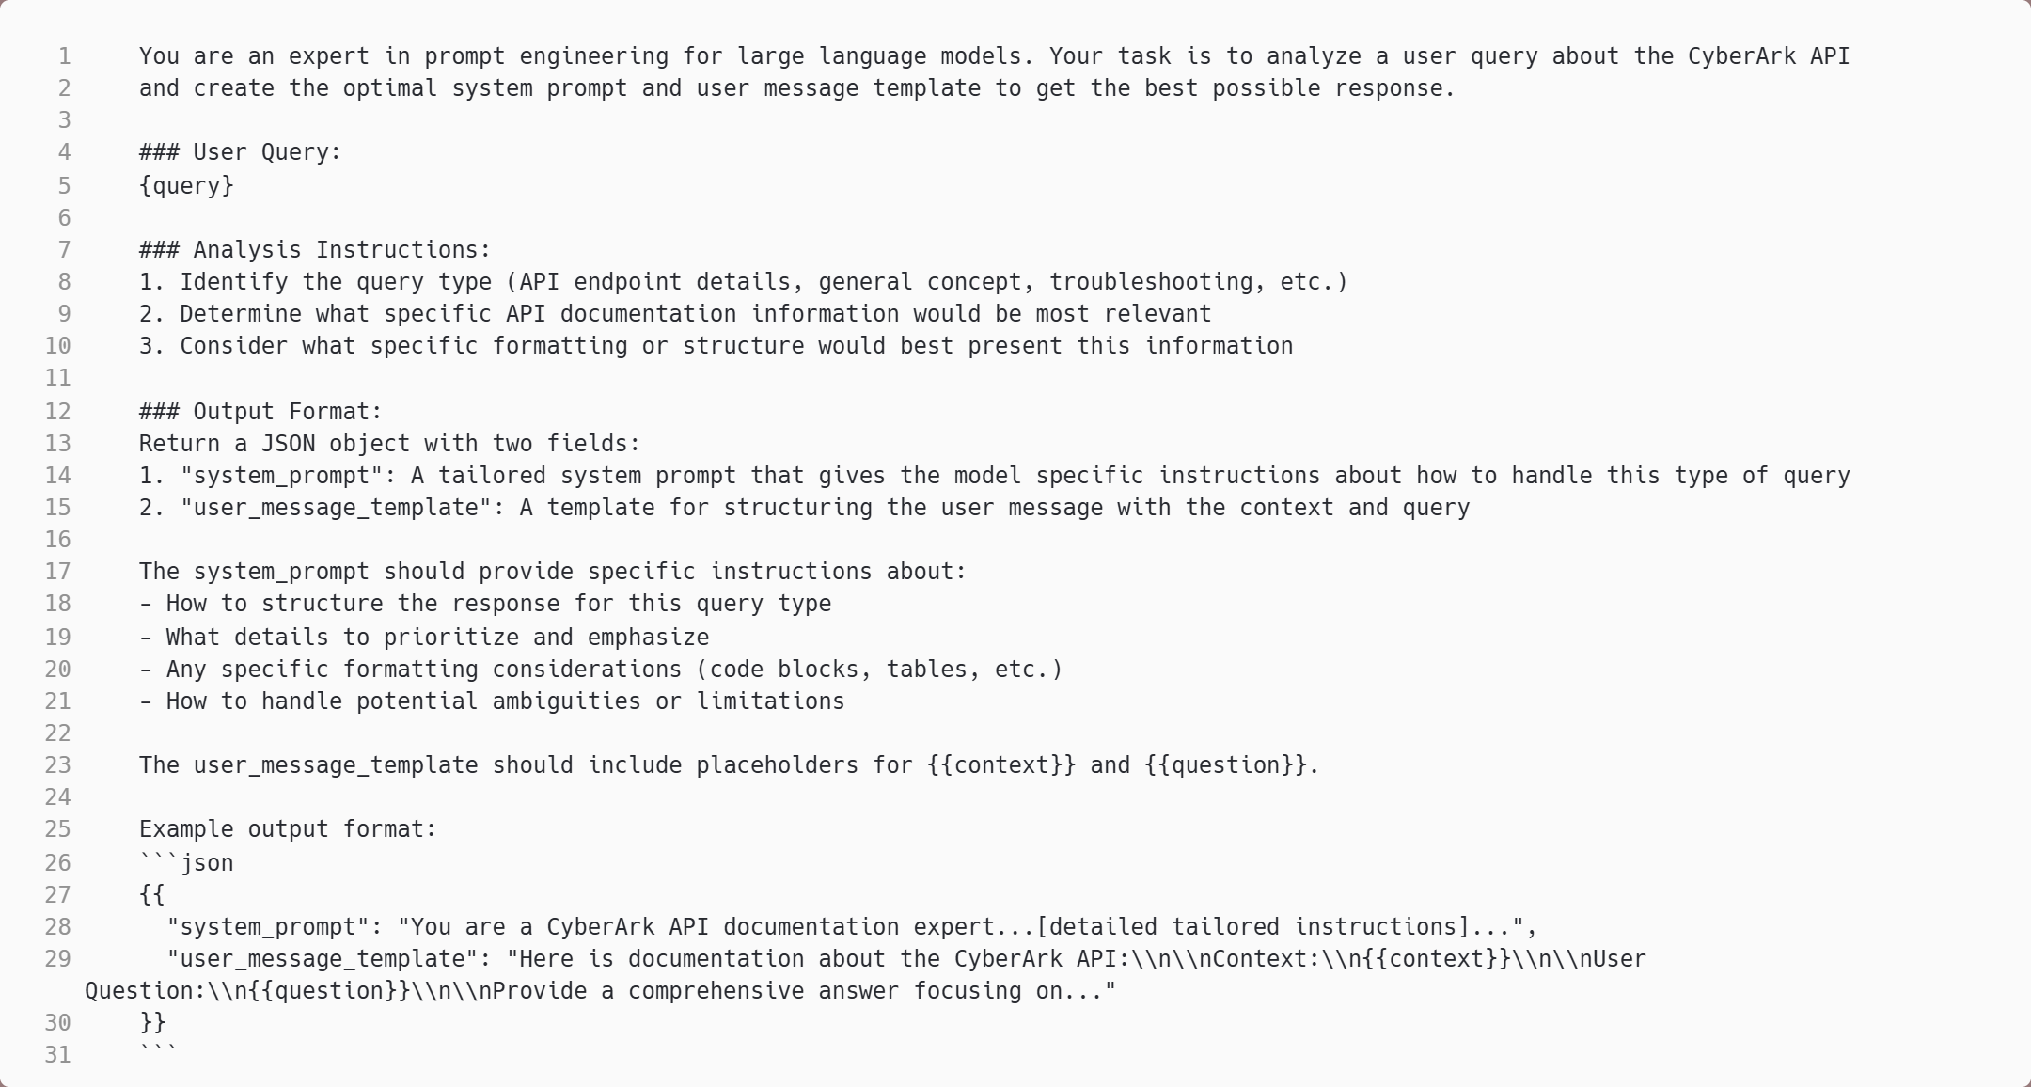
Prompt used to generate System Prompt and User Message template

Slide 18
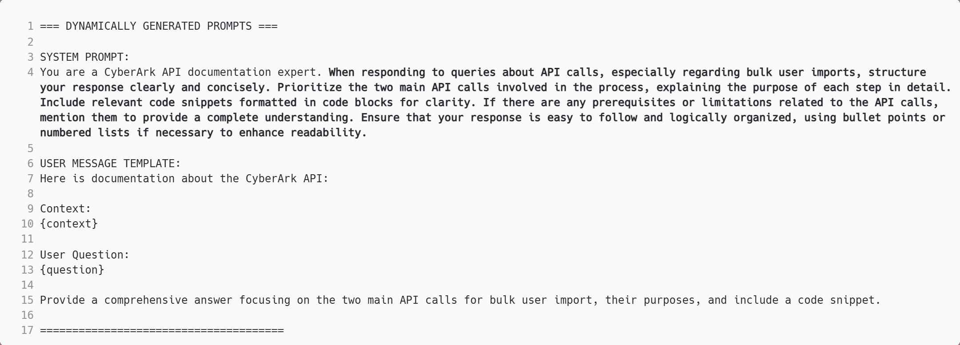
Dynamically generated System Prompt

Slide 19
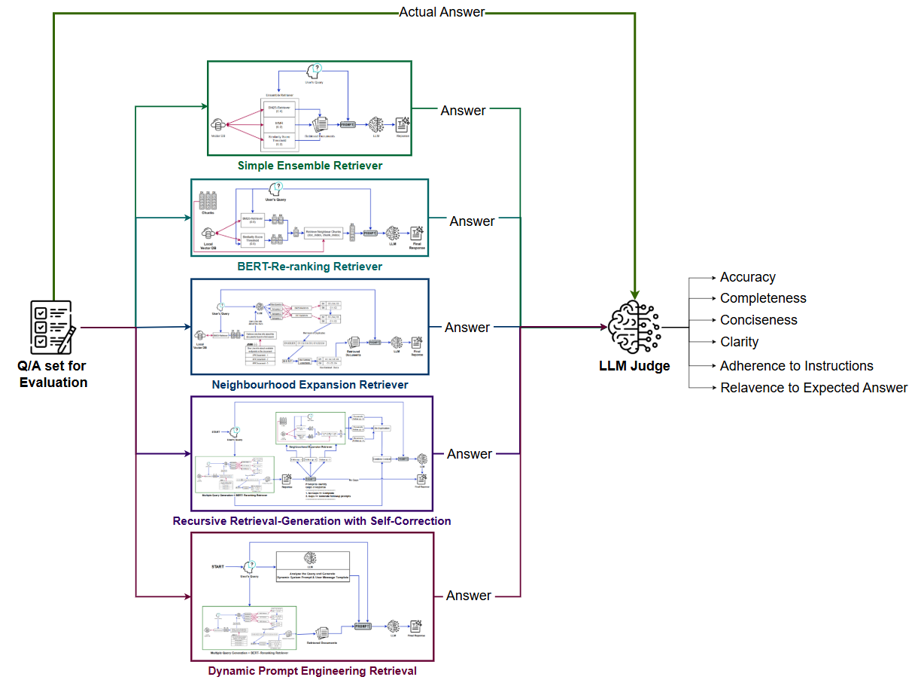
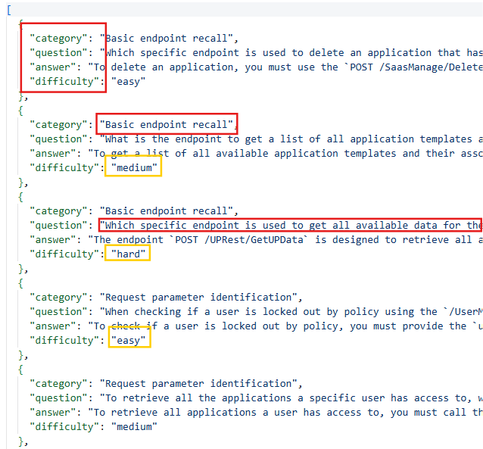
LLM-as-a-judge

Slide 20
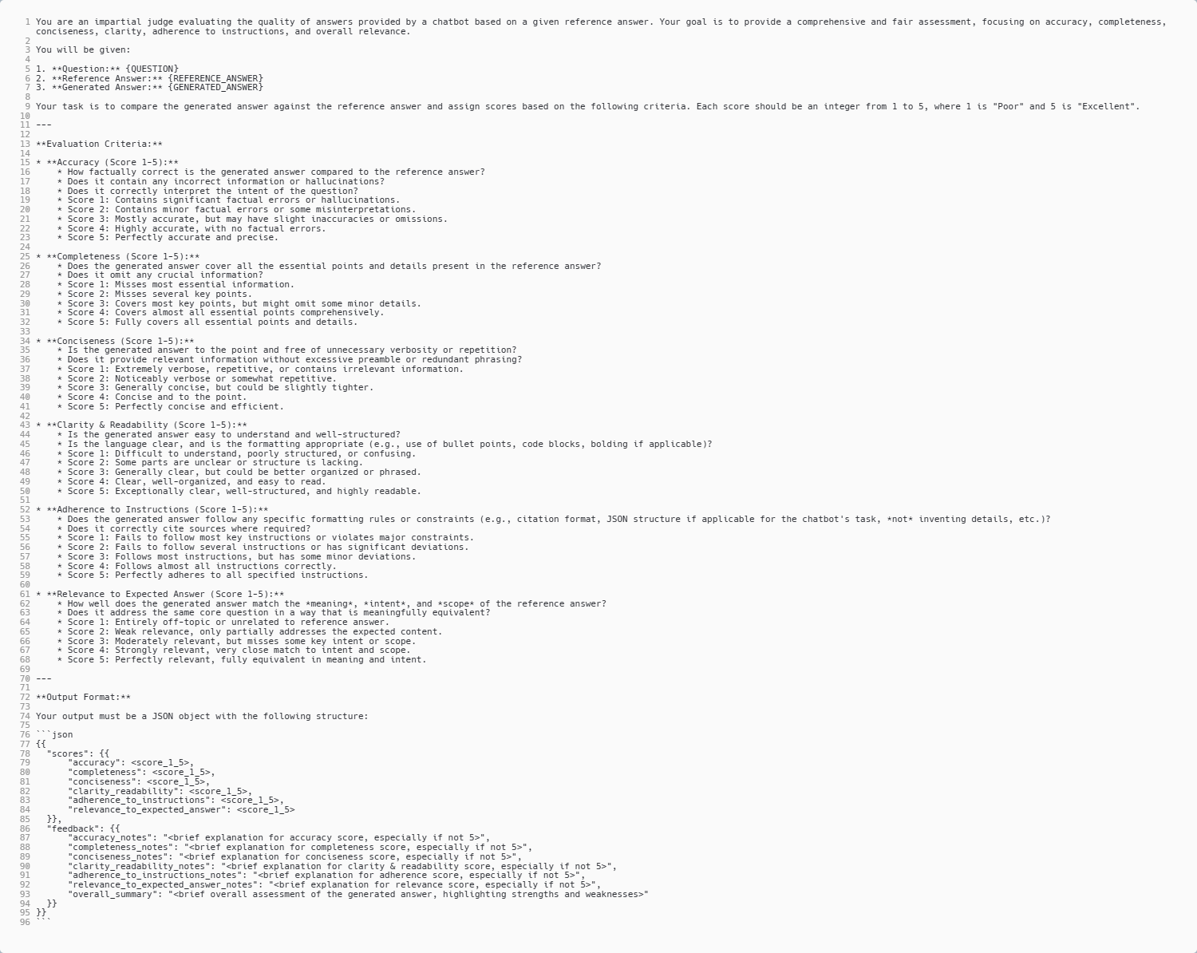
Query used for LLM Evaluation

Slide 21
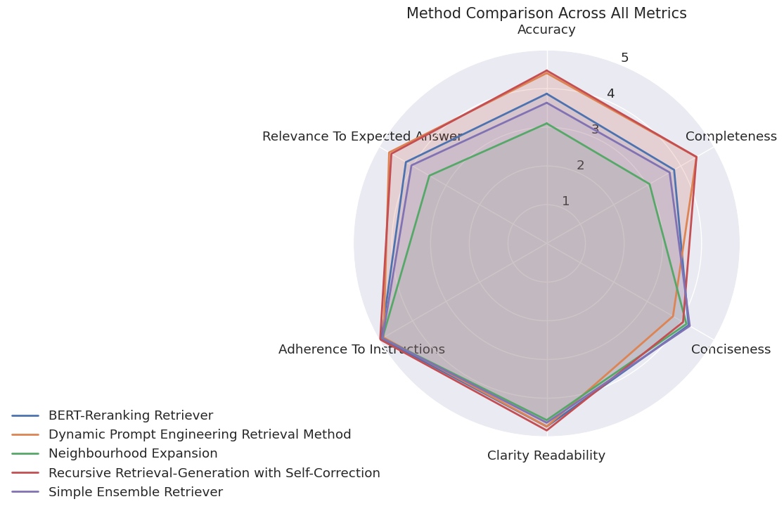
Results

Slide 22
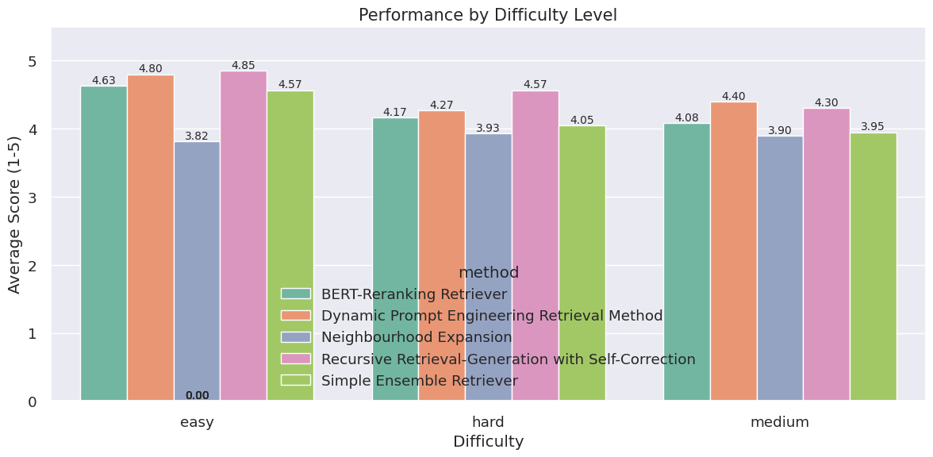
Results

Slide 23
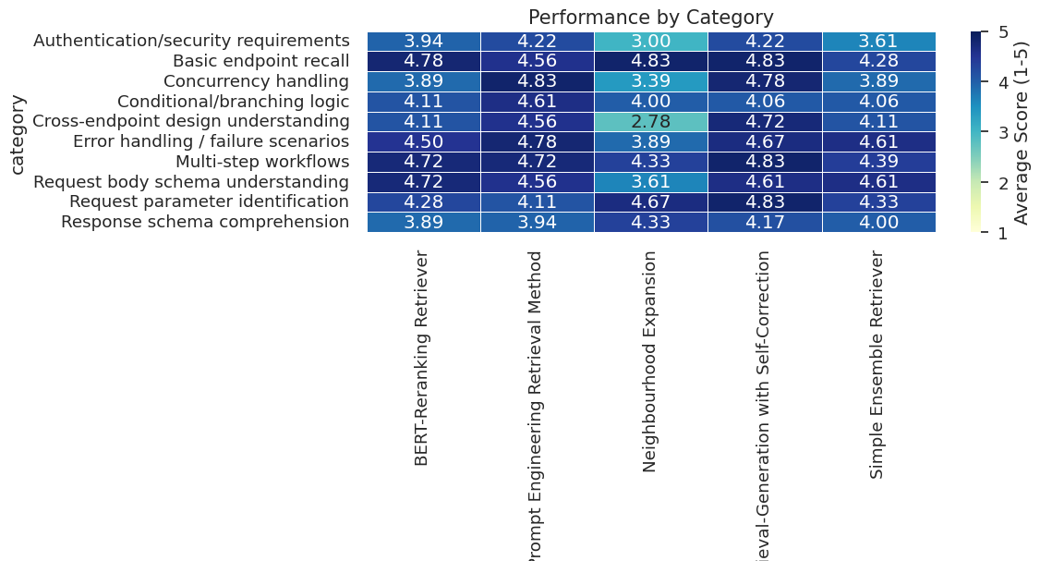
Results

Slide 24
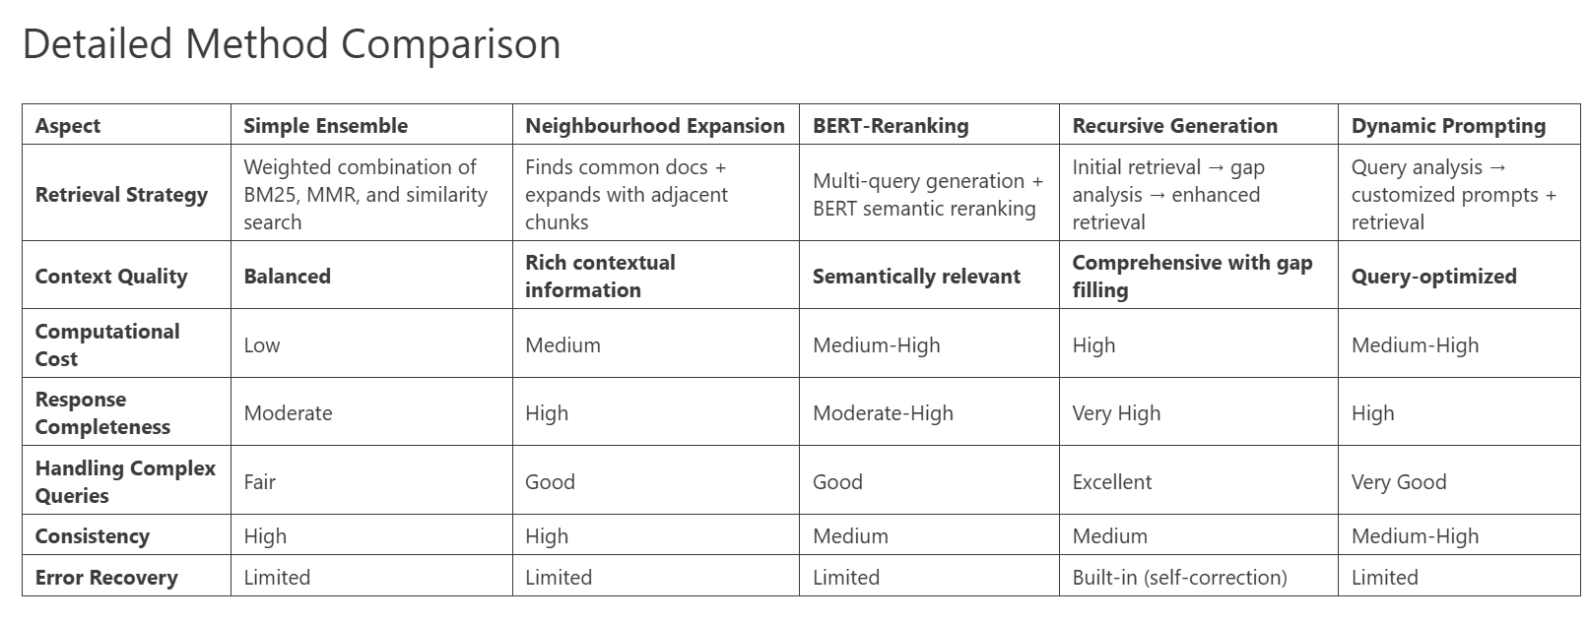
Comparison

Slide 25
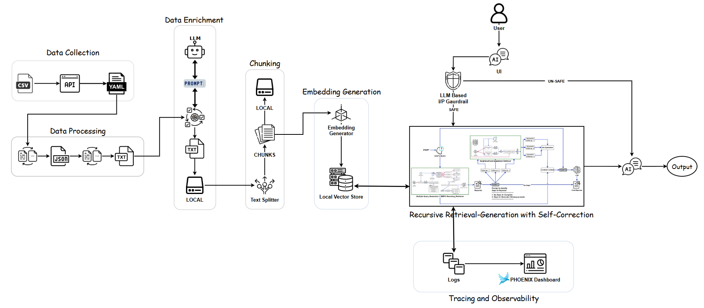
Final RAG Pipeline

Slide 26
[ DEMO ]

Slide 27
THANK YOU!

